Slide 1
Section 2.6: Impossibility and Alternative Ballots
Math for Liberal Studies

Slide 2
Which Method to Use?
We have seen many methods, all of them flawed in some way
Which method should we use?
Maybe we shouldn’t use any of them, and keep searching for a better way

Slide 3
Arrow’s Theorem
In 1951, Kenneth Arrow proved that this search will be in vain
There is no voting system that satisfies all of the following conditions:
always gives a winner (except for ties)
is not a dictatorship
independence of irrelevant alternatives
Pareto condition
voters rank their candidates in order

Slide 4
Arrow versus May
May’s theorem told us that with 2 candidates, there is only one system that satisfies certain “fairness” conditions
Arrow’s theorem tells us that with more than 2 candidates, there is no system that satisfies certain “fairness” conditions

Slide 5
We Can’t Have Everything
Arrow proves we can’t have all of these:
always gives a winner (except for ties)
is not a dictatorship
independence of irrelevant alternatives
Pareto condition
voters rank their candidates in order
What should we give up?

Slide 6
Always Gives a Winner?
Do we want to use a voting system that doesn’t always give a winner?
An example of this is Condorcet’s method

Slide 7
Not a Dictatorship
If we allow our voting system to be a dictatorship, that means that there is a single voter that determines the outcome for everyone
That hardly seems “fair”

Slide 8
Independence of Irrelevant Alternatives
This is the “spoiler effect” we studied earlier
Many of the common voting systems (plurality, rank methods) suffer from this problem

Slide 9
Pareto Condition
Remember that the Pareto condition says that if every single voter prefers A over B, then B shouldn’t win
That seems like something we should have, though we could use sequential pairwise voting if we give this up

Slide 10
Voters Rank Preferences in Order
Every system that we have studied has used ranked preferences
Is there another way for voters to express their preferences?

Slide 11
Types of Ballots
We will look at 4 types of ballots
Single-vote: Voters choose a single candidate
Rank: Voters rank candidates from best to worst
Approval: Voters can choose multiple candidates to cast votes for
Range: Voters rate each candidate on a scale

Slide 12
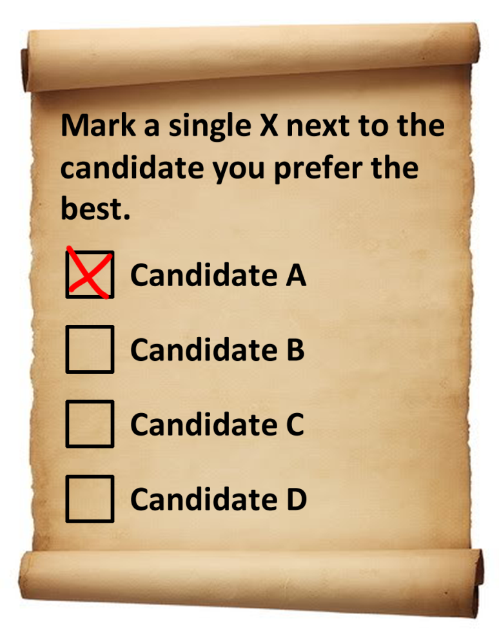
Type 1: Single-Vote Ballot
This is the ballot most of us are familiar with
Many of the methods we have studied (Condorcet, rank, runoff, etc.) are impossible with this ballot type

Slide 13
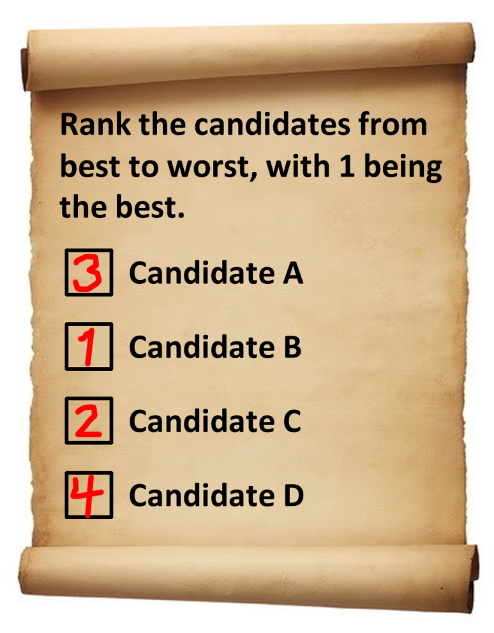
Type 2: Rank Ballot
This is the kind of ballot we would need to use the methods we have studied
Every candidate must be ranked, and ties are not allowed

Slide 14
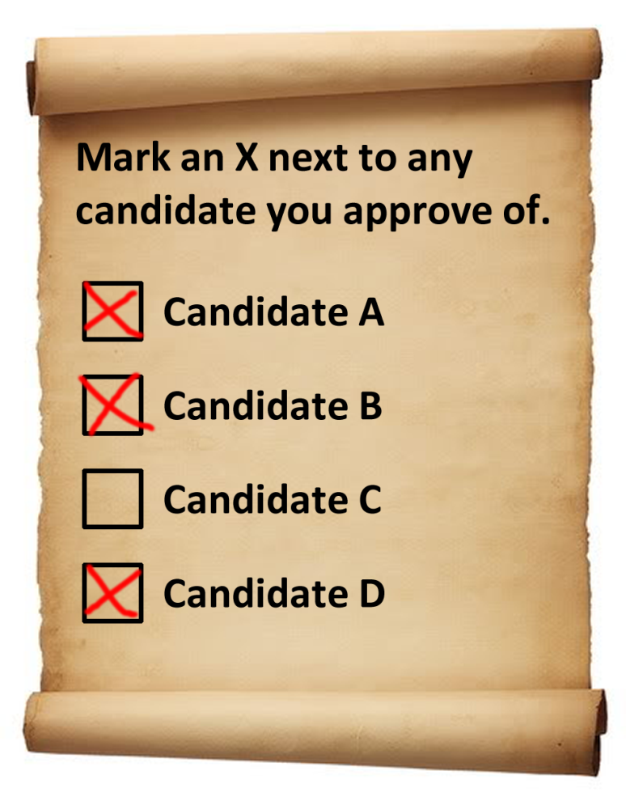
Type 3: Approval Ballot
This generalizes the single-vote ballot
Allows voters to vote for minor party candidates and major party candidates at the same time

Slide 15
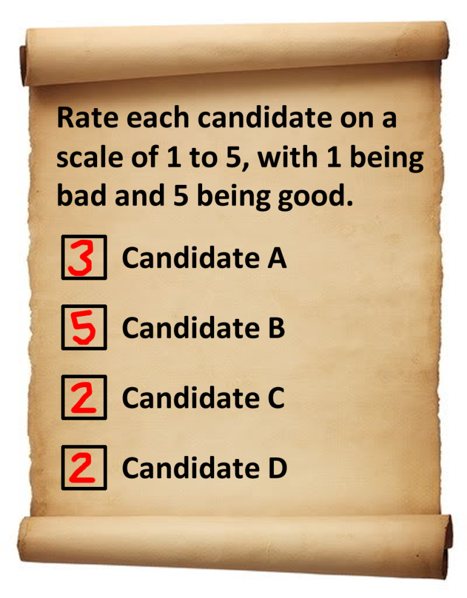
Type 4: Range Voting
Similar to a rank ballot, but voters assign each candidate a score
In this example, the scale is 1 to 5, but the scale could be anything, as long as it is the same for each voter

Slide 16
Using Ballots
We already know how to use the first two types of ballots to decide the winner of an election
Now we will look at how to use these two new ballot types to decide a winner

Slide 17
Approval Voting
Add up all the votes each candidate gets
The candidate with the most votes wins

Slide 18
Example of Approval Voting
The results of an approval vote are shown here
For example, 6 people approved of both E and F
Number of Ballots | Results
 | E | F | G | H
6 | X | X
5 |  | X
5 |  |  | X
4 | X | X |  | X
2 |  |  |  | X
1 | X

Slide 19
Example of Approval Voting
E got 6+4+1=11 votes
F got 6+5+4=15 votes
G got 5 votes
H got 4+2=6 votes
F wins!
Number of Ballots | Results
 | E | F | G | H
6 | X | X
5 |  | X
5 |  |  | X
4 | X | X |  | X
2 |  |  |  | X
1 | X

Slide 20
Problems with Approval Voting
We can assume that voters are still using (mental) preference lists, but simply have a “cutoff” above which they approve of a candidate and below which they do not
Suppose we have a voter with preference order B > D > A > C

Slide 21
Problems with Approval Voting
This voter could cast his approval ballot in 5 ways:
Approve of no one
Approve of B only
Approve of B and D
Approve of B, D, and A
Approve of everyone

Slide 22
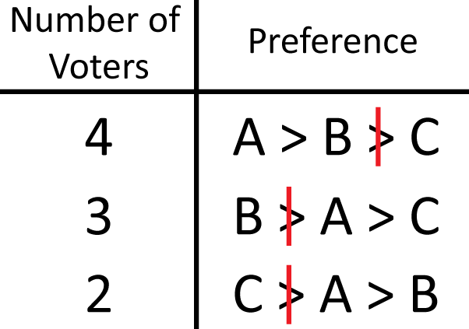
Problems with Approval Voting
Now consider this profile, with approval cutoffs as shown
The approval results are:
A has 4 votes
B has 7 votes
C has 2 votes

Slide 23
Problems with Approval Voting
So B is the approval winner
However, since we have preferences we can use other methods as well
In fact, A is the Condorcet winner!

Slide 24
Problems with Approval Voting
The previous example showed us that approval voting doesn’t satisfy the Condorcet winner criterion
There is another problem that we’ll see in the next example

Slide 25
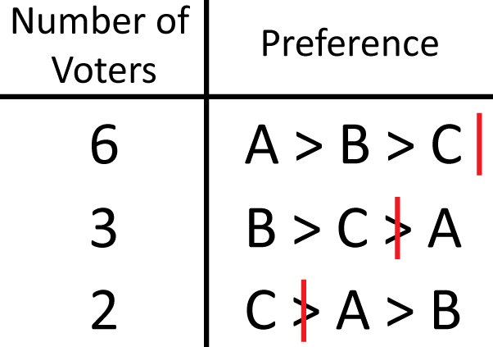
Problems with Approval Voting
In this profile, the approval results are:
A gets 6 votes
B gets 9 votes
C gets 11 votes
So C wins the approval vote

Slide 26
Problems with Approval Voting
However, if we look at the plurality results:
A gets 6 votes
B gets 3 votes
C gets 2 votes
A is the plurality winner (with a majority!) but comes in last using approval voting

Slide 27
Range Voting
Add up all the points each candidate gets
The candidate with the most points wins

Slide 28
Example of Range Voting
Number of Ballots | Results
 | E | F | G | H
8 | 5 | 4 | 3 | 1
5 | 3 | 5 | 2 | 2
5 | 1 | 1 | 5 | 1
4 | 4 | 3 | 2 | 5
1 | 5 | 3 | 3 | 3
The results of an approval vote are shown here
For example, 8 people rated E with 5 points, F with 4 points, G with 3 points, and H with 1 point

Slide 29
Example of Range Voting
Number of Ballots | Results
 | E | F | G | H
8 | 5 | 4 | 3 | 1
5 | 3 | 5 | 2 | 2
5 | 1 | 1 | 5 | 1
4 | 4 | 3 | 2 | 5
1 | 5 | 3 | 3 | 3
We compute the winner just like we did for rank voting, but this time there isn’t one point system that all the voters are using

Slide 30
Example of Range Voting
Number of Ballots | Results
 | E | F | G | H
8 | 5 | 4 | 3 | 1
5 | 3 | 5 | 2 | 2
5 | 1 | 1 | 5 | 1
4 | 4 | 3 | 2 | 5
1 | 5 | 3 | 3 | 3
Edward | Fiona | Gretchen | Harry
8 × 5 = 40 | 8 × 4 = 32 | 8 × 3 = 24 | 8 × 1 = 8
5 × 3 = 15 | 5 × 5 = 25 | 5 × 2 = 10 | 5 × 2 = 10
5 × 1 = 5 | 5 × 1 = 5 | 5 × 5 = 25 | 5 × 1 = 5
4 × 4 = 16 | 4 × 3 = 12 | 4 × 2 = 8 | 4 × 5 = 20
1 × 5 = 5 | 1 × 3 = 3 | 1 × 3 = 3 | 1 × 3 = 3
Total: 81 | Total: 77 | Total: 70 | Total: 46
E is the winner with 81 points!

Slide 31
Problems with Range Voting
We can think of approval voting as being a special kind of range voting
In approval voting, the scale is only 0 or 1
0 means “I don’t approve”
1 means “I approve”

Slide 32
Problems with Range Voting
Since we saw earlier that approval voting has problems, and approval voting is just a special kind of range voting, range voting has those same problems

Slide 33
Looking on the Bright Side
Even with its problems, range voting satisfies four of the five conditions of Arrow’s theorem:
always gives a winner (except for ties)
is not a dictatorship
independence of irrelevant alternatives
Pareto condition
voters rank their candidates in order

